Slide 1
Health data and Disease Recommender System
Group No. 1:
Ruchita Garde, Manasa Potluri, Jay Palan, Mingrui Han.
Notes:
The Presentation Slides - each group will prepare a Power Point presentation based on its research paper and any demonstration prototype software.
The Group Presentation - this group presentation, consisting of Power Point slides, will be used on our Research Day to present your findings to the entire class. This is a knowledge-sharing exercise in that you must convey your results to members of the class who may not be fully familiar with the background knowledge that you have accumulated in your research. You should try to bring everyone "up-to-speed" on your topic. It is a good idea to choose one person to be the moderator for the group, give an overview of the project, and then introduce the other members who will present their respective portions of the project.
Each group will have about 20-30 minutes to present, including any demo of prototype software.
Everyone in the group should participate in the group presentation. Each member will receive an individual grade for their portion of the presentation.

Slide 2
Introduction
Problem Statement
Related Work
Technical Approach
Working demo
Implementation
Future Scope
Conclusion
OUTLINE

Slide 3
Introduction
Problem Statement
Related Work
Technical Approach
Working demo
Implementation
Future Scope
Conclusion
INTRODUCTION

Slide 4
Introduction
12 million diagnostic errors a year
Rare diseases often forgotten
Market gap
Reasons behind misdiagnosis

Slide 5
Introduction
Problem Statement
Related Work
Technical Approach
Working demo
Implementation
Future Scope
Conclusion
Problem Statement

Slide 6
Problem Statement
Aim of the project
To build:
Symptoms → Disease
Diseases → Symptoms
GUI
ICD-10 code of a disease
Processing of output before giving to user

Slide 7
Introduction
Problem Statement
Related Work
Technical Approach
Working demo
Implementation
Future Scope
Conclusion
RELATED WORK
Notes:
research we did in the field of health data, health systems, recommendation systems and standardized medical terminology

Slide 8
Related Work Section
Introduction of key terminologies and concepts
Knowledge-based Systems
ICD-10
OWL

Slide 9
Knowledge-based Systems
Knowledge-based systems are capable of making decisions based on the knowledge residing in them, and can understand the context of the data that is being processed.
Onconcin
It provides treatment advice to physicians administering experimental chemotherapy to cancer patients.
ATHENA
It provides guidelines for hypertension using EON architecture for blood pressure control. ATHENA has a modifiable knowledge system. It is designed to allow clinical experts to customize the knowledge base to incorporate the evolved the disease symptoms.

Slide 10
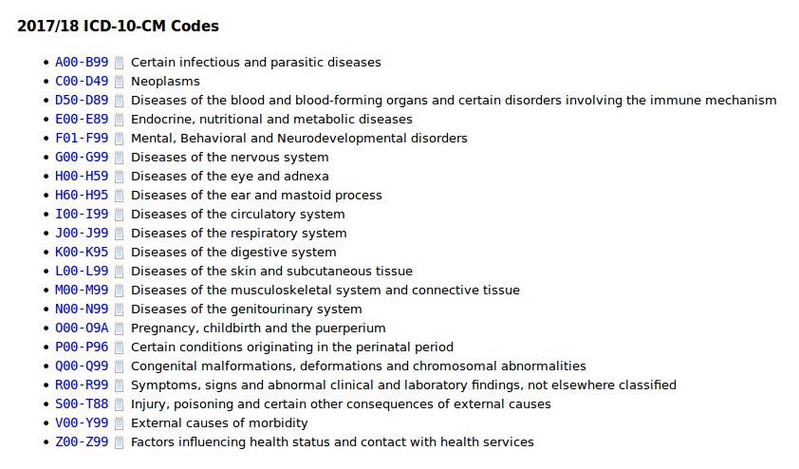
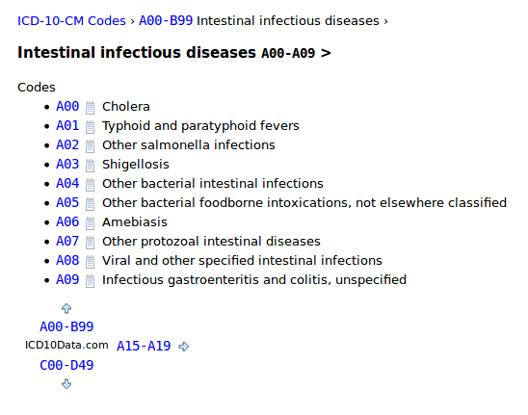
ICD-10
International classification of diseases-version 10 (ICD-10) is a diagnosis coding system used in hospitals for data retrieval and billing purposes.

Slide 11
OWL
The OWL, Web Ontology Language is a language for defining and instantiating Web Ontologies.
distribute across many systems.
scalable to web needs
compatible with web standards
open and extensible.

Slide 12
Introduction
Problem Statement
Related Work
Technical Approach
Working demo
Implementation
Future Scope
Conclusion
TECHNICAL APPROACH
Notes:
prototype system, a high level-design, and conceptualizing real world scenarios to the project architecture

Slide 13
Technical Approach
Use Case Development
Block Diagram Development
Knowledge-Based Recommendation System

Slide 14
Use Case
An actor/user should be able to interact in 4 ways with the system: ‘Enter symptoms’, ‘Get diseases’, ‘Enter diseases’, ‘Get symptoms’.
Our target users are health practitioners and patients, whom we assume to be non-technical people.
A directed relationship exists between pairs of use cases signified by <<include>> which means, ‘Enter symptoms’ is a part of and needs to happen before ‘Get diseases’, and ‘Enter diseases’ is a part if and needs to happen before ‘Get symptoms’.

Slide 15
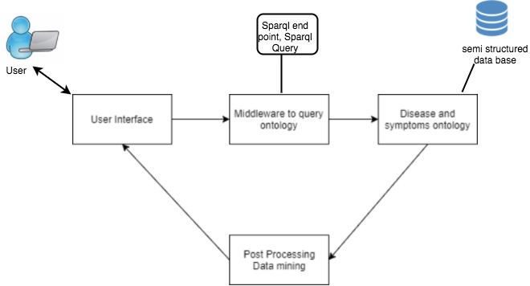
Block Diagram

Slide 16
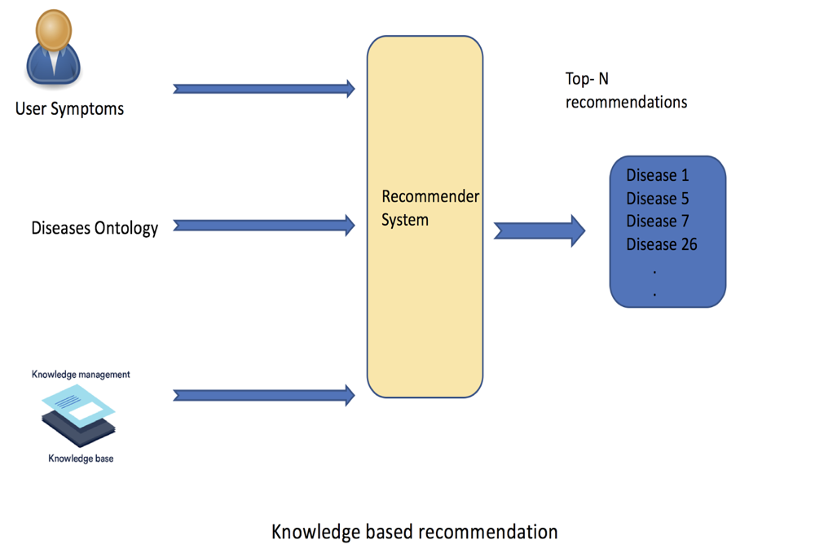
Knowledge Based Recommendation System
When a system needs to exploit additional knowledge to generate recommendations, a knowledge-based approach is needed. Such knowledge may be elicited interactively by interacting with the user.
If the solution is not found, however, the requirements must be changed by the user. Optionally, explanation for the recommendation may also be provided to the user.

Slide 17
Introduction
Problem Statement
Related Work
Technical Approach
Working demo
Implementation
Future Scope
Conclusion
WORKING DEMO
Notes:
prototype system, a high level-design, and conceptualizing real world scenarios to the project architecture

Slide 18
Working Demo
Disease Symptom Ontology
Sparql queries
Ontology up on the net at : http://www.jaypalan.com/EHR.owl
User Interface

Slide 19
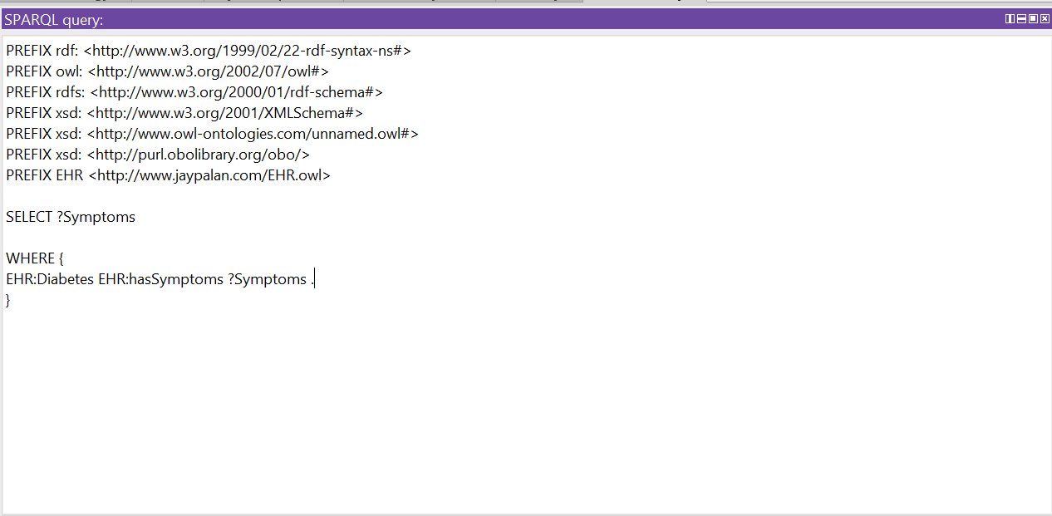
1)Finding all symptoms of a disease.

Slide 20
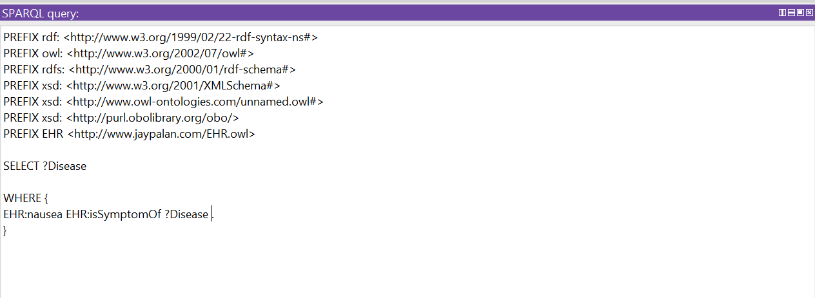
2)Finding diseases related to a symptom.

Slide 21
Introduction
Problem Statement
Related Work
Technical Approach
Working demo
Implementation
Future Scope
Conclusion
IMPLEMENTATION
Notes:
prototype system, a high level-design, and conceptualizing real world scenarios to the project architecture

Slide 22
Implementation
Post Processing
Data mining

Slide 23
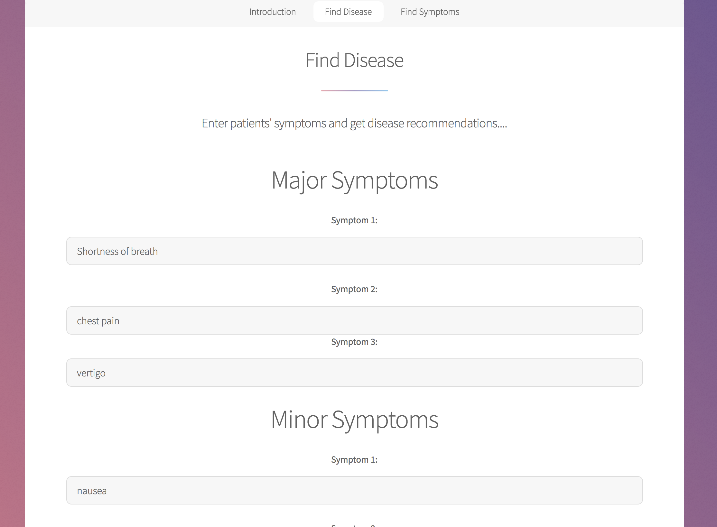
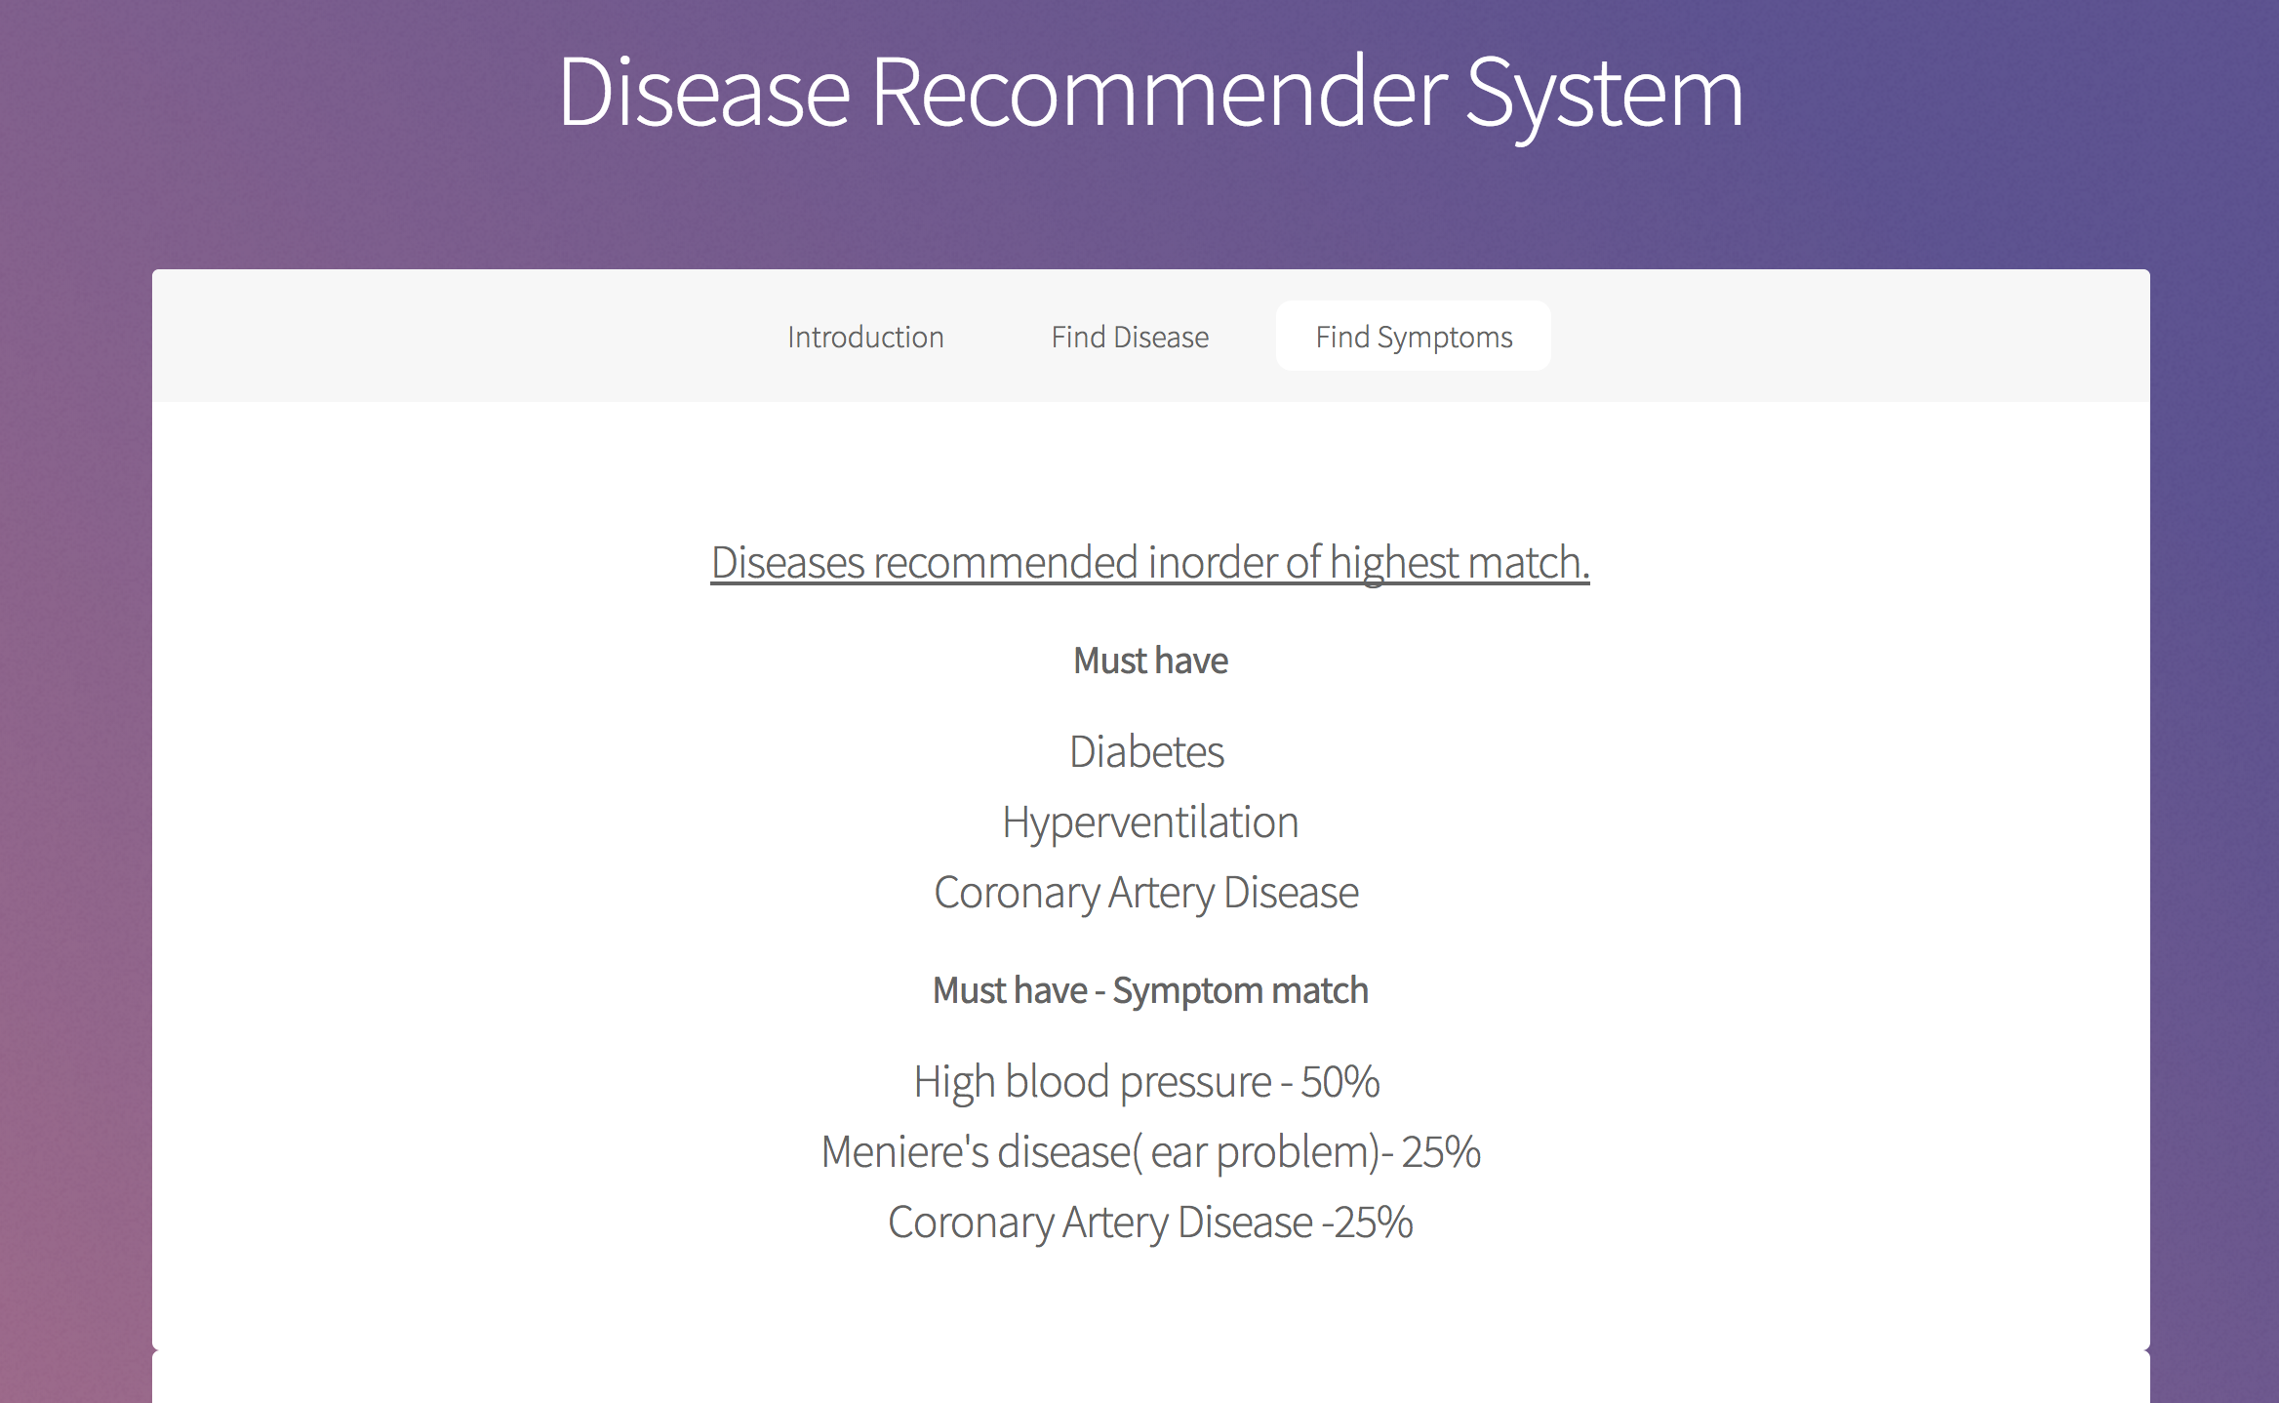
USER INTERFACE :
Find the diseases through Symptoms

Slide 24
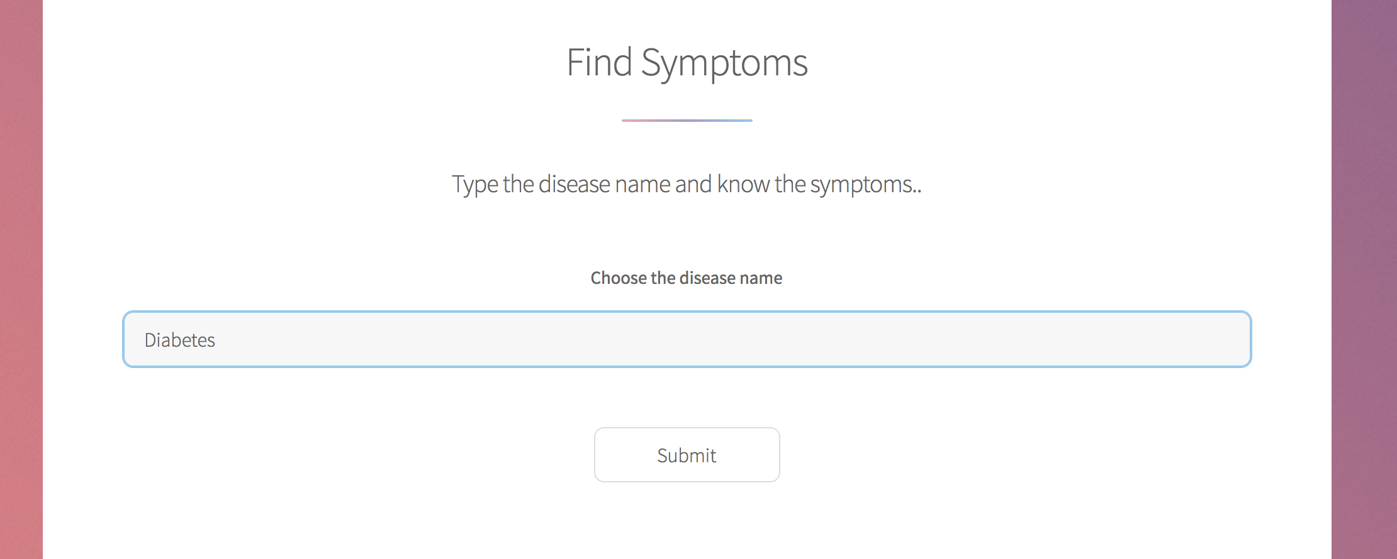
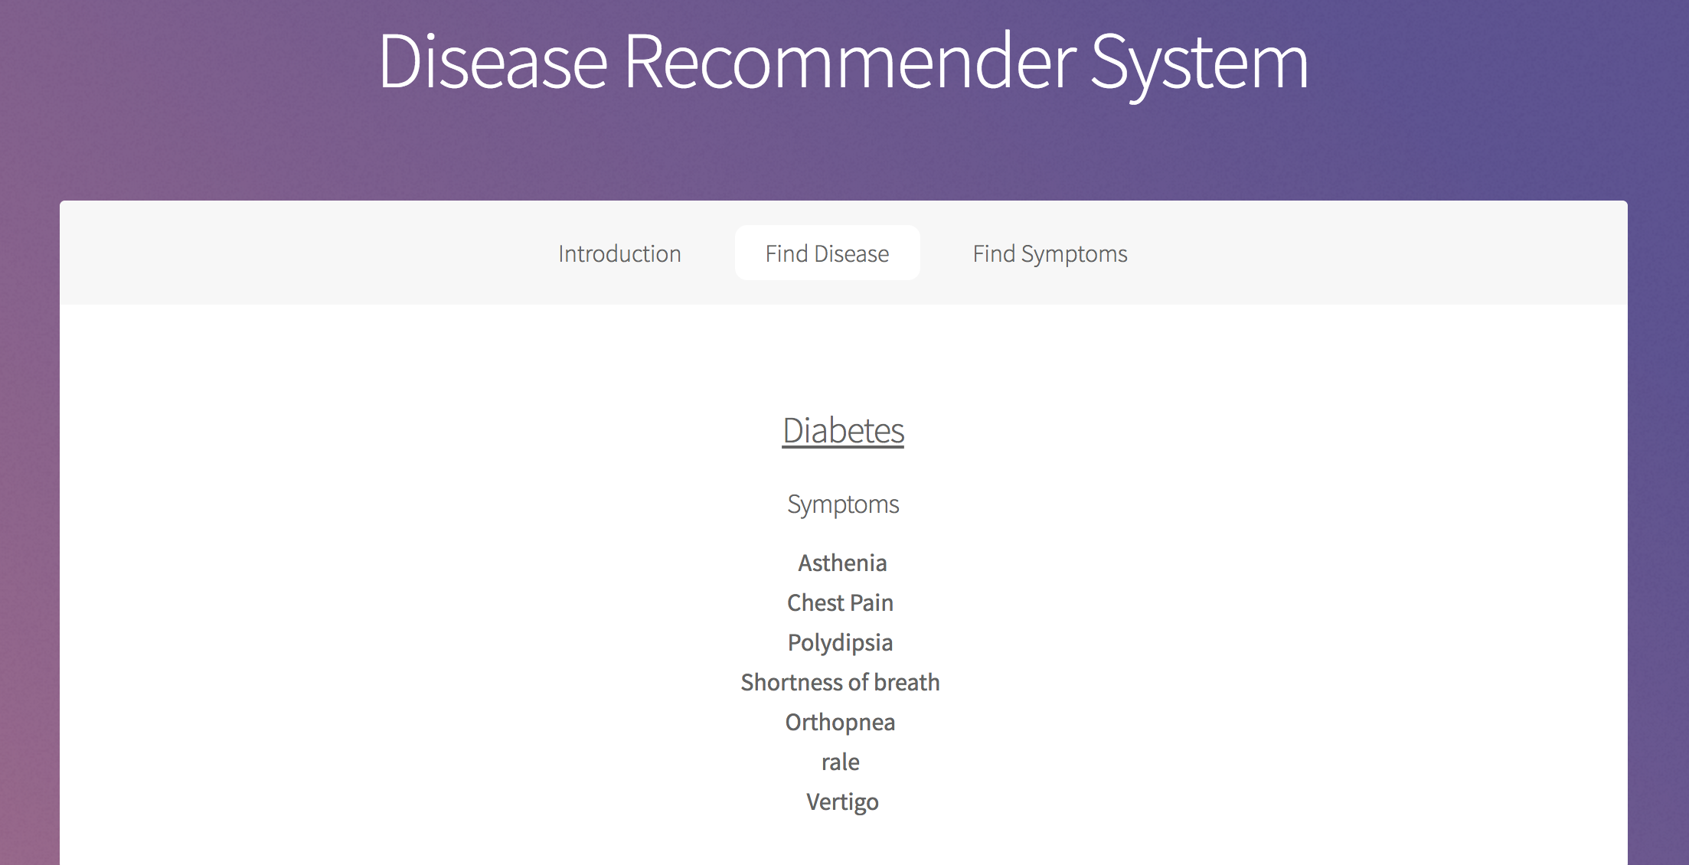
Find the symptoms for disease

Slide 25
Post Processing
First, the disease that must have the symptom.
Even though the disease description contains the literal word of the symptom, different diseases may be related to the same symptom differently.
Eg. Disease 1 has symptom: fever, diarrhea
Disease 2 has symptom: fever, diarrhea, gas, vomiting, dizziness
Querying symptoms: fever, diarrhea
Disease 1 is closer to the correct result. Further sorting is needed.

Slide 26
Post Processing
Second, the disease that may have the symptom.
The disease matches some of the query and does not match the rest of the query
Eg. Disease 1 has symptom: fever, diarrhea
Disease 2 has symptom: fever, diarrhea, gas, vomiting, dizziness
Querying symptoms: fever, headache
Which one is closer to the query. Further sorting is also needed.

Slide 27
Post Processing Technique
We further sort the disease based on the likelihood for it to be related to the symptom, using cosine similarity as the data mining technique.
Define the symptoms list S and result disease names list D.
S1:fever, S2:diarrhea, S3:gas, S4:vomiting, S5:dizziness
D1: fever, diarrhea, gas
D2: fever, gas
D3: fever, gas, vomiting, dizziness

Slide 28
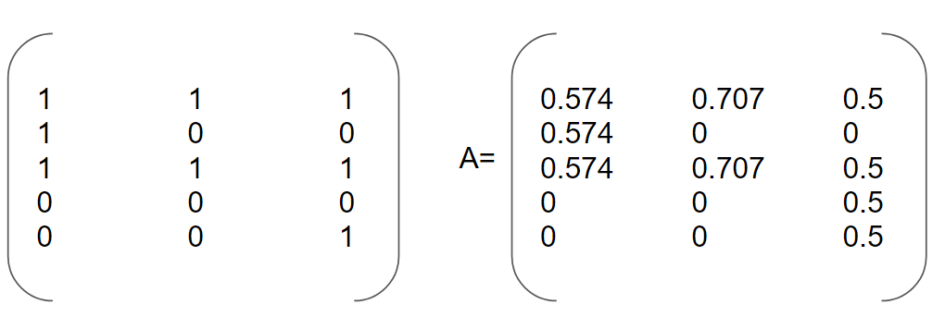
Data Mining
Construct symptom(5) by disease(3) matrix.
Column is each disease. Row is each symptom. If disease has symptom, the location value is 1, else is 0. Then we normalize the matrix based on each column so that the Euclidean norm is 1.

Slide 29
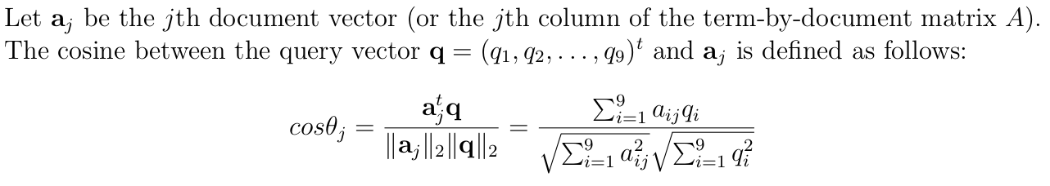
Data Mining
Suppose we want to query symptom fever and gas. Create a query vector q(1,0,1,0,0)

Slide 30
Data Mining
cos(D1) = (0.574*1+0.574*1)/ sqrt(2) = 1.148/sqrt(2) = 0.812
cos(D2) = (0.707+0.707)/sqrt(2) = 1
cos(D3) = (0.5*1+0.5*1)/sqrt(2) = 1/sqrt(2) = 0.707
In this case, disease 2 has the greatest similarity value. Disease 3 has the least similarity value. So the output order will be D2, D1, D3, indicating the input symptom (fever, gas) will most likely to be disease 2, then disease 1, then disease 3.

Slide 31
Introduction
Problem Statement
Related Work
Technical Approach
Working demo
Implementation
Future Scope
Conclusion
FUTURE SCOPE
Notes:
prototype system, a high level-design, and conceptualizing real world scenarios to the project architecture

Slide 32
Future Work
Hemoptysis : coughing up blood or blood-stained mucus
We will let users to search every term they want instead of choosing from existing one. Description will not have the exact word of the symptom term. We need to find alternative word of the symptom. (synonyms of symptom word)

Slide 33
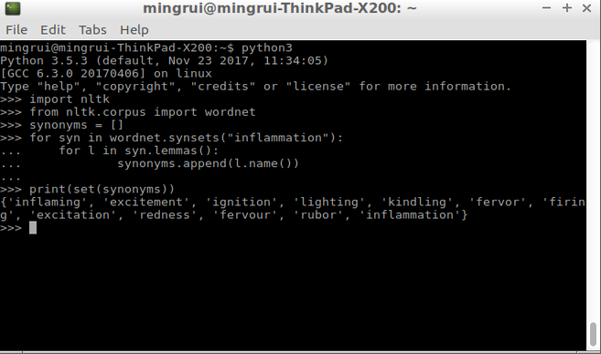
Future Work
We can use several existing synonyms library to extend the range of search of the symptoms.

Slide 34
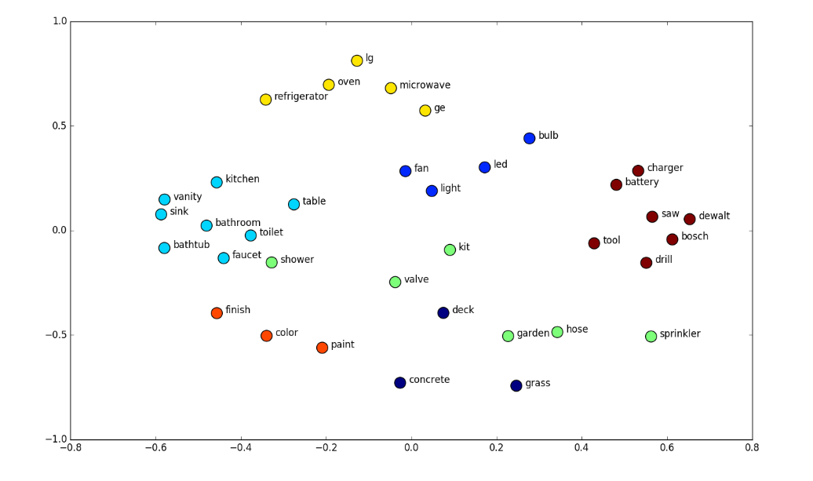
Future Work
Extract the semantic meaning of the input symptom.
Semantic embeddings:
PCA, Word2Vec, Glove
https://deeplearning4j.org/word2vec
Uses neural network, more accurate

Slide 35
Future Work
Current Design - connect UI to MYSQL
Future Design - connect UI to SPARQL endpoint
Consider more attributes like age, medical history, hereditary, allergies
Show other symptoms of the diseases found

Slide 36
Introduction
Problem Statement
Related Work
Technical Approach
Working demo
Implementation
Future Scope
Conclusion
CONCLUSION
Notes:
prototype system, a high level-design, and conceptualizing real world scenarios to the project architecture

Slide 37
Conclusion
Summary of Efforts, Research and Results:
Read research papers to understand medical field.
Integrated capabilities of UI development, ontology development and data mining.
Learning:
The medical field is vast & complicated and needs a lot of research and effort.
It’s difficult but not impossible to build such a system.
Notes:
Talk about research papers..Prof likes research papers

